Slide 1

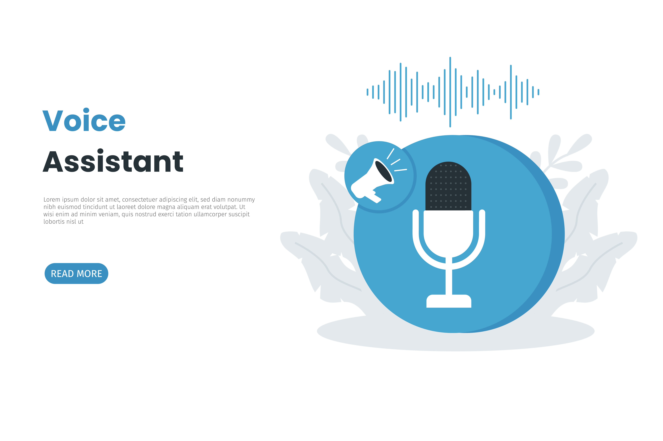
Progress Presentation 02
Automated Sinhala Voice Assistant to manage tasks using Natural Language Processing – Sri Voice
Group 2022 - 200

Slide 2
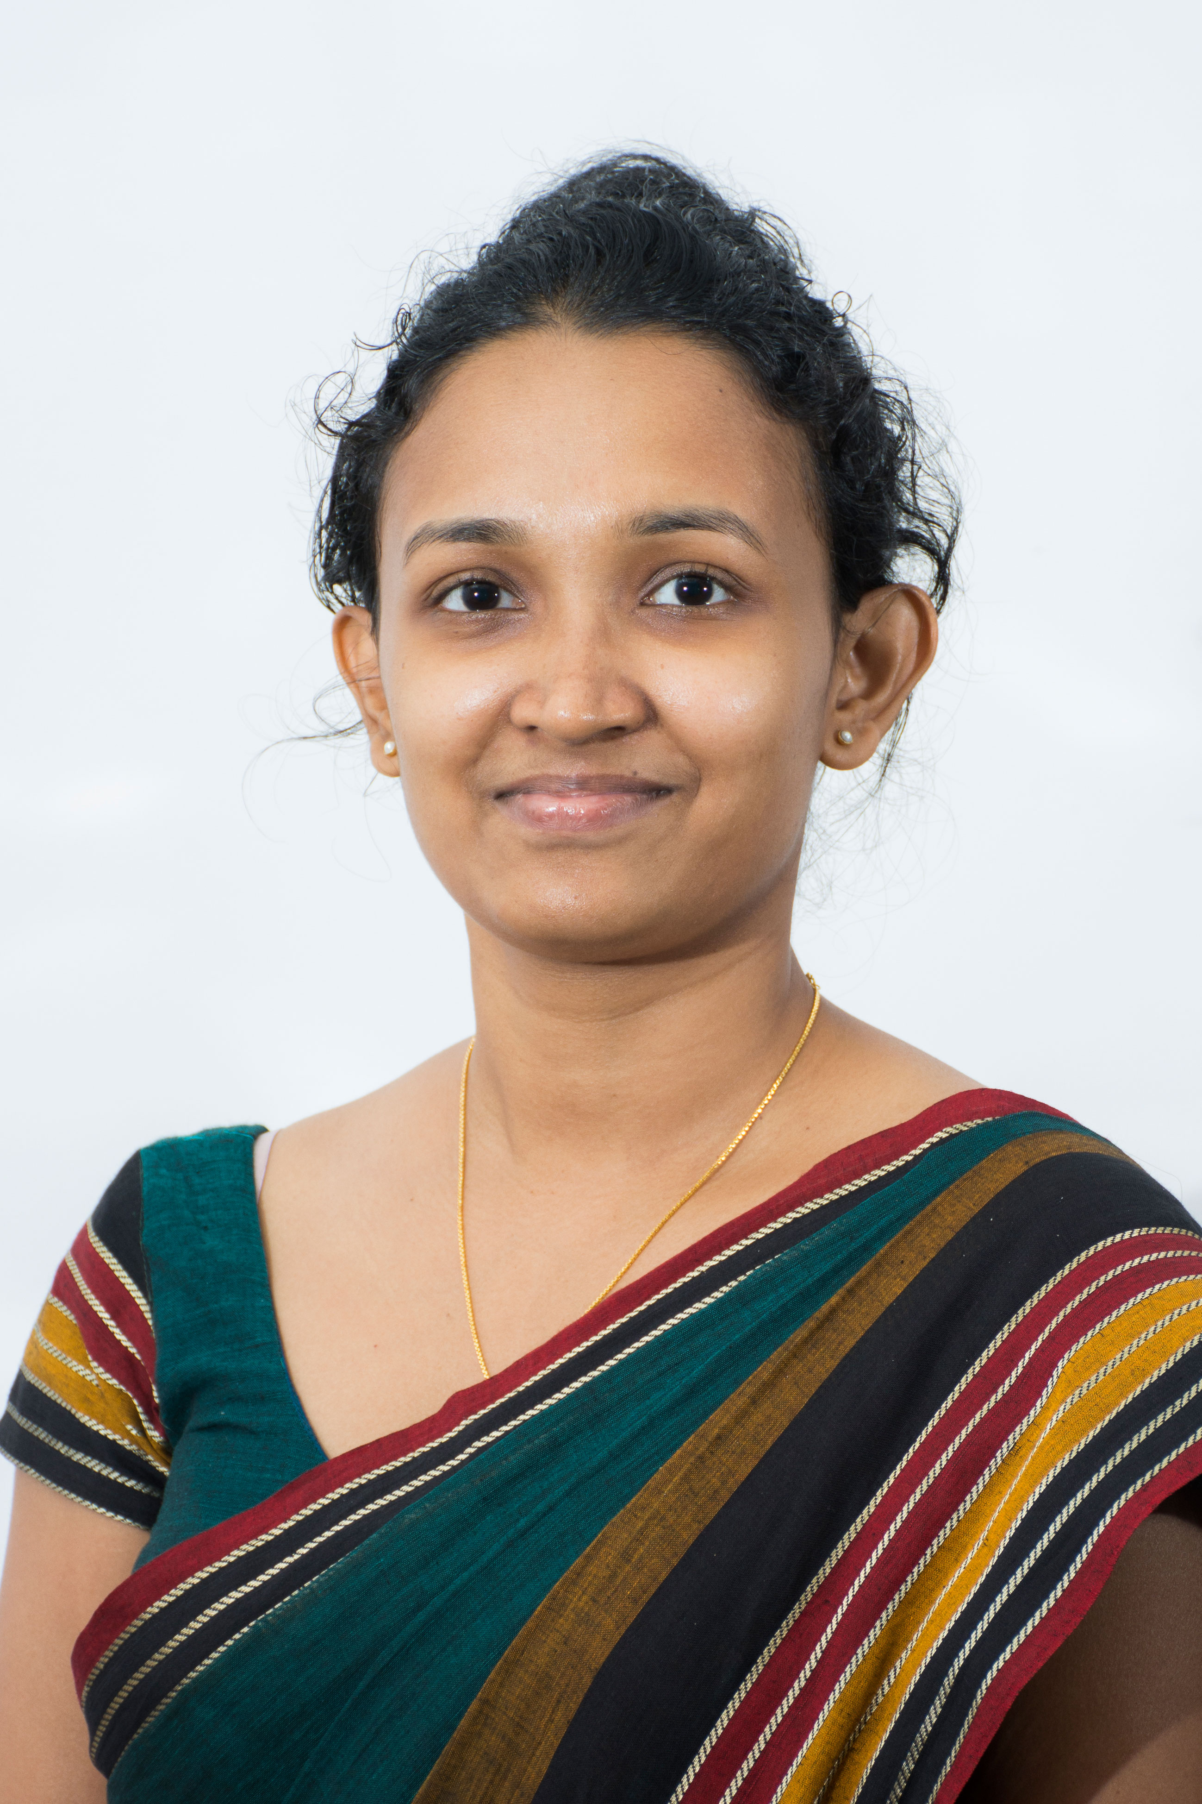
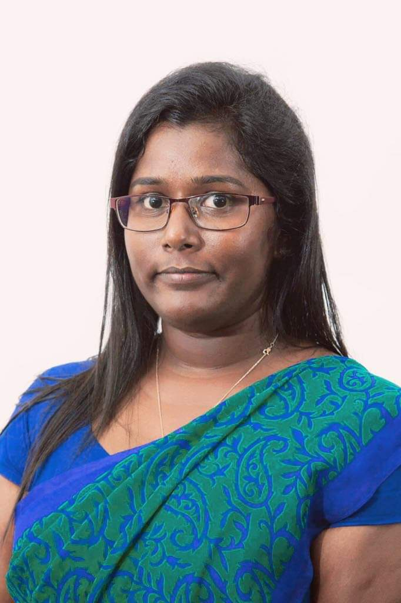
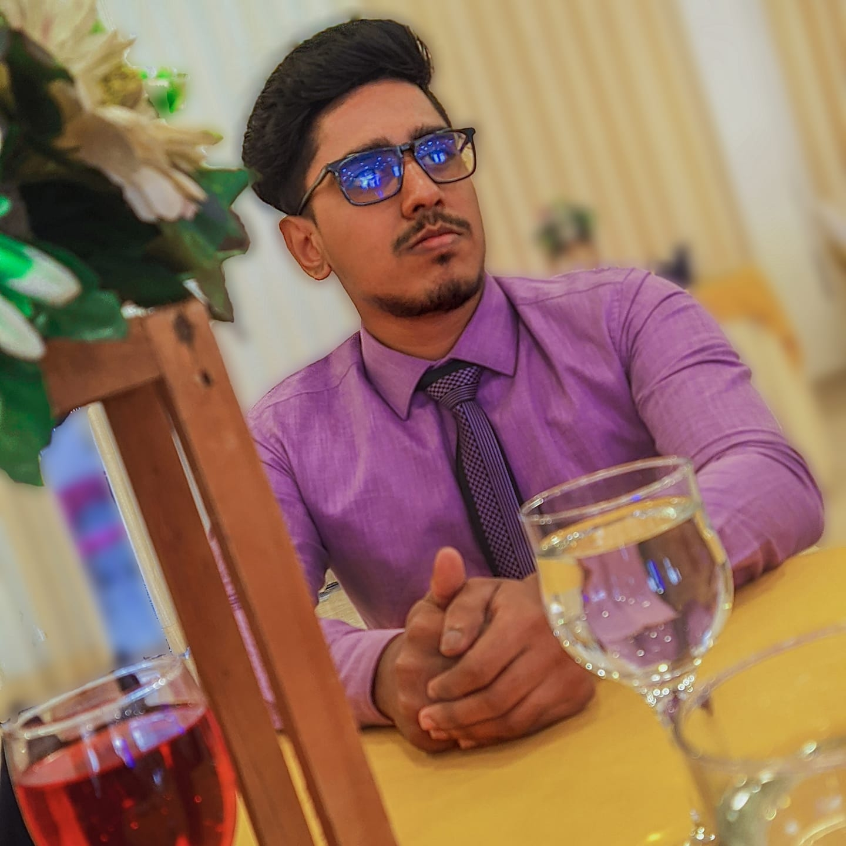
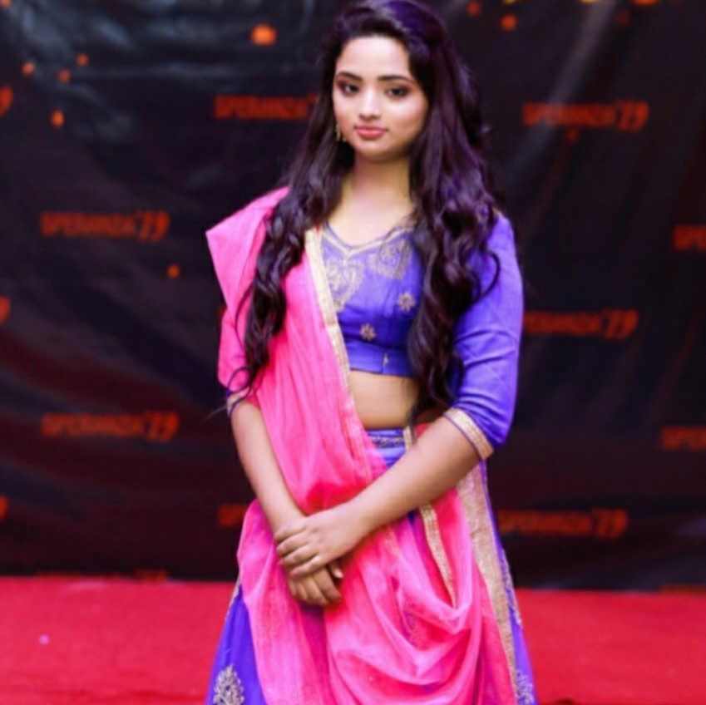
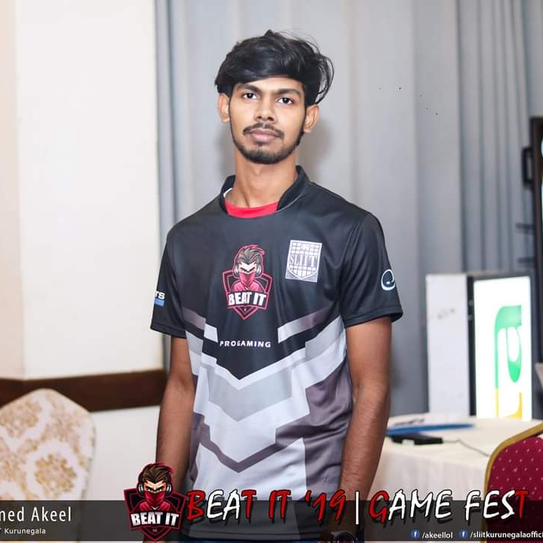
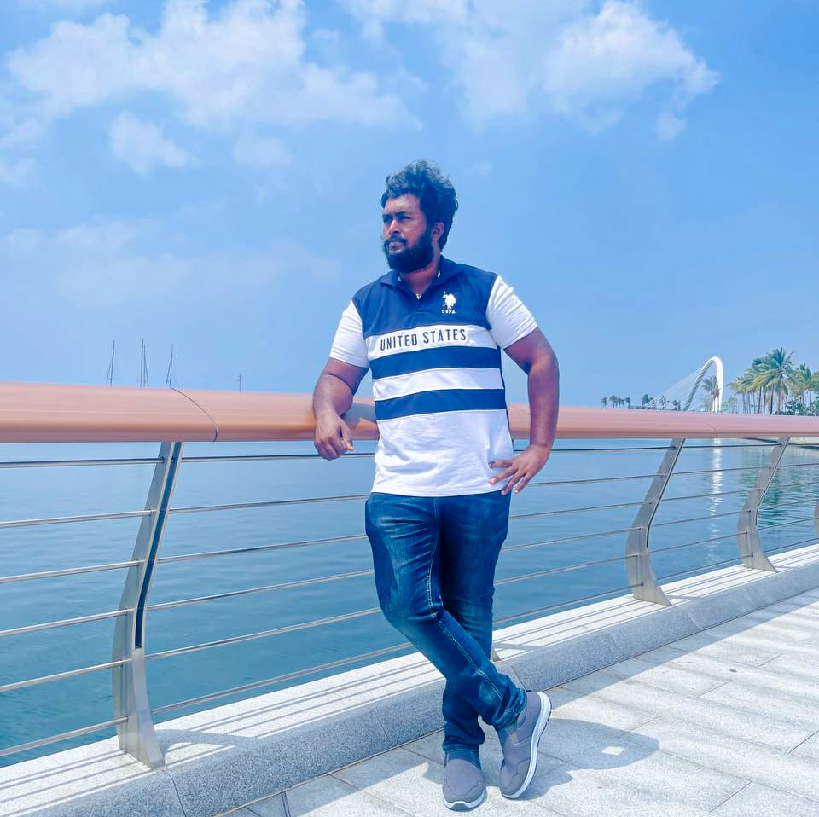
Meet The Team
Ms. Dinuka Wijendra
Supervisor
Ms. Jenny Krishara
Co-Supervisor
Senarathne K.H.I.R.
Group Leader
Member 04
Bandara V.D.
Member 01
Herath H.M.C.P.
Member 02
Nirash J.M.I.
Member 03

Slide 3
Introduction
Over 4.2 billion digital voice assistants are being used in devices around the world.
Forecasts suggest that by 2024, the number of digital voice assistants will reach 8.4 billion units.
Many Asian countries have voice assistant applications in their native language (Korea – Clova).
As Sri Lankans, We don’t have a voice assistant functioning using our native language.
English language-based voice assistant applications come with some challenges,
Mainly,
Accent issues in English
Lack of English literacy

Slide 4


Business Plan
Company Description
Products and Services
Sri voice company mainly provides Sinhala Voice assistant application to the users who potentially get benefits from it.
Sri voice provides the first ever fully functional Sinhala voice assistant smartphone app for the people of Sri Lanka.
This Application mainly focuses on Sri Lankan people but anyone who uses the Sinhala language can have benefited from using Sri voice mobile app.
Other than the voice assistant application Sri voice provides a website with a support system for the benefit of its users.

Slide 5
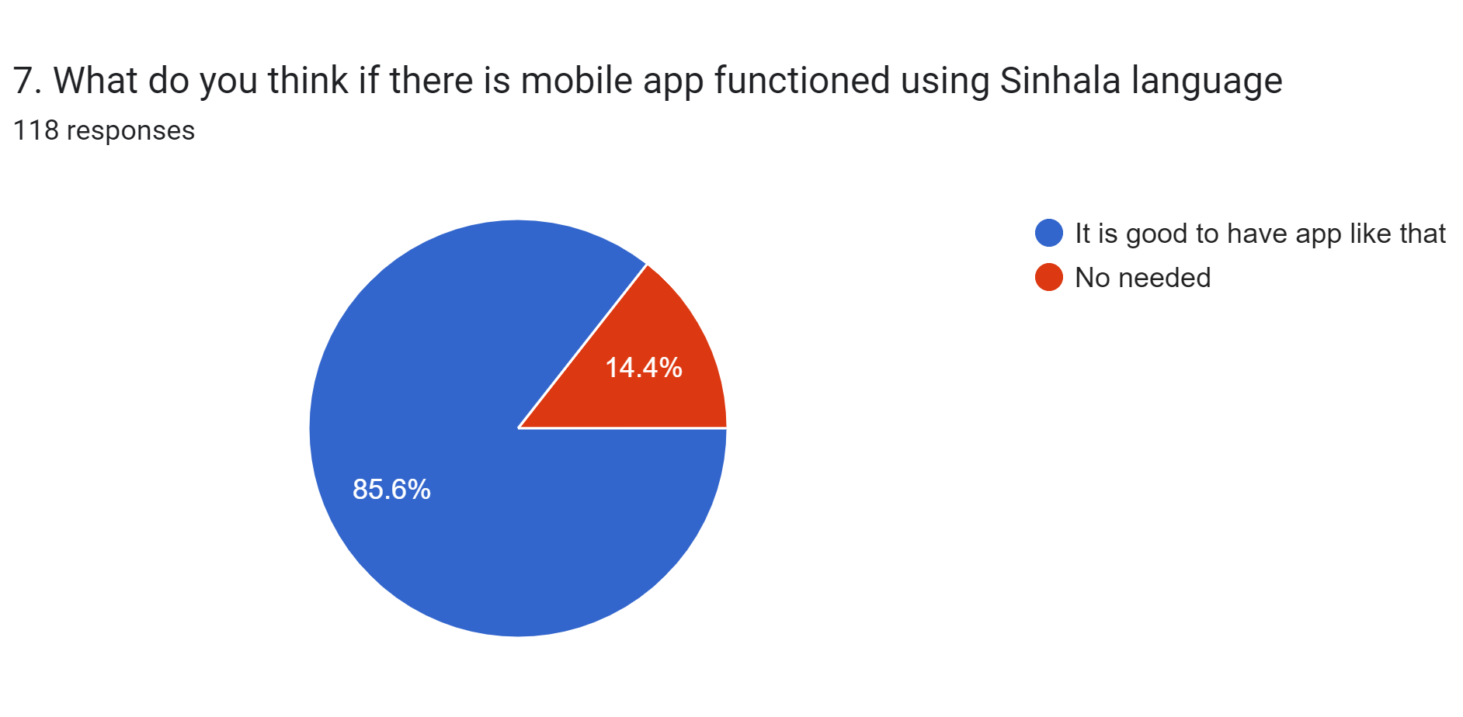
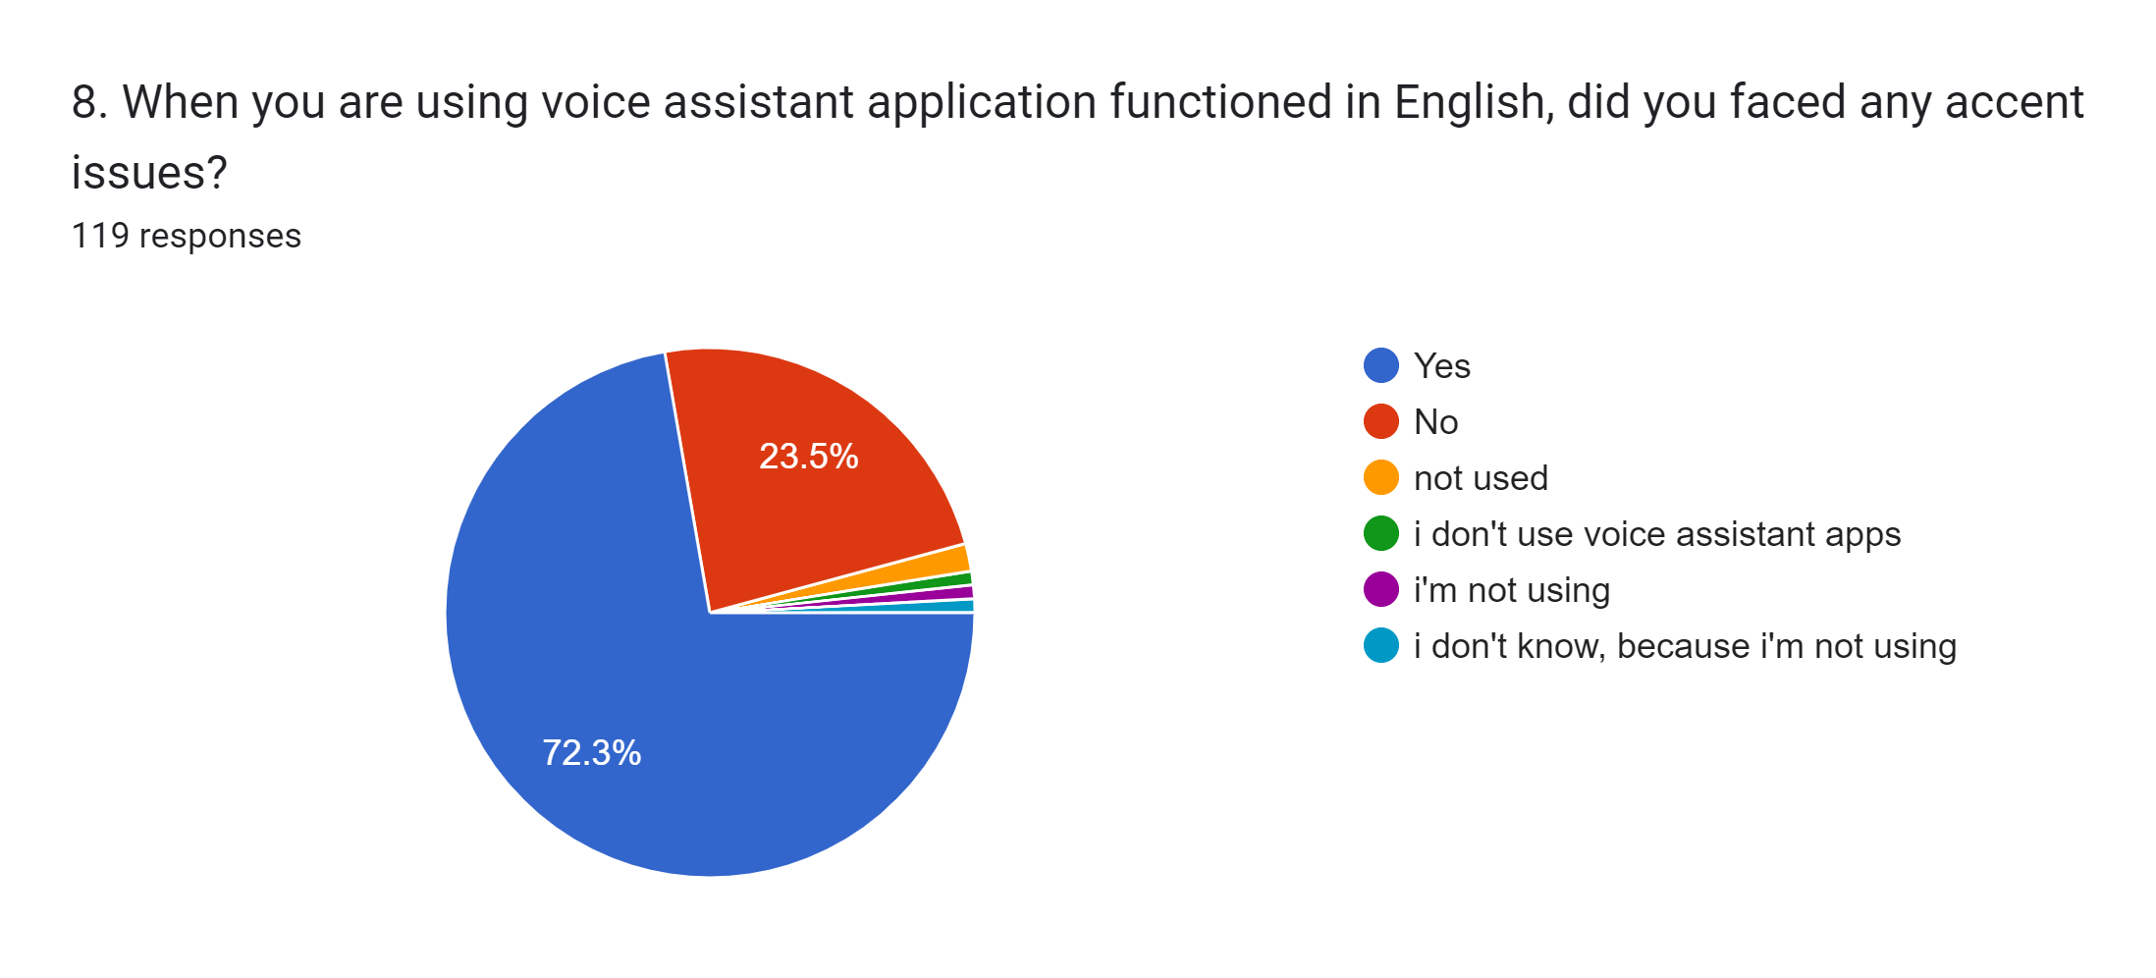
Business Plan
Market analysis
Financial Plan
To facilitate its distribution, this app is intended to be hosted on Amazon Web Services (AWS), and all the technical infrastructure necessary to install it through Google Play will be made available to users.
There are expenses associated with using amazon web service(AWS). It is expected that some money will be spent on advertising initiatives that make use of social media. This software may also be used by the google play store. It can be considered as the primary income here.

Slide 6
Business Plan
Target audience
Social Media Marketing
Sri Lankan people
People who use Sinhala Language
People with accent issues in foreign languages
People who cannot speak English
People who value the Sinhala Language
The deployed application to the server can be commercialized using intro video demonstrations, Facebook banners, Social media posts, and social media
ad campaigns.

Slide 7
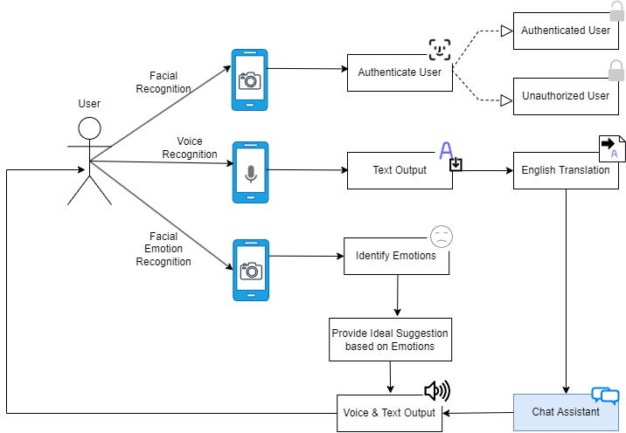
Overall System Overview Diagram

Slide 8
User Authentication Using Facial Recognition
Herath H.M.C.P
IT19216010

Slide 9

Research Questions
How to give a speed authentication method instead of traditional password authentication.
How to capture array of snapshots of the users face automatically?
How to increase the accuracy of face recognition within less period? (seconds)
How to identify face of the user without distracting from background contents?
IT19216010 | Herath H.M.C.P. | 2022-200

Slide 10

Specific and Sub Objectives
Specific Objective
Identify the accurate face of the user and authenticate and provide easy access to the application while improving the security
Sub Objectives
Identify the object whether it is a face or not.
Extract the face from the background.
Check the similarity index of the faces and identify the user.
Authenticate the user and give access.
IT19216010 | Herath H.M.C.P. | 2022-200

Slide 11
Requirements
Functional Requirements
Should have a method to identify user’s face.
Should have a method to extract face from the background.
Should have a method to capture snapshots.
Should have a method to authenticate the user
Should have a method to check the accuracy of the identified face.
Non-Functional Requirements
Efficiency and performance of the of face recognition.
Handle errors efficiently.
Provide maximum accuracy.
Provide an easy interface for physically challenged and disabled people.
User Requirements
provide easy access within less time to the user while improving the security.
IT19216010 | Herath H.M.C.P. | 2022-200

Slide 12
How I Started?
As a first step I Learned technology from scratch, because of less experience in python programming.
Study about machine learning concepts and done sample projects for train those.
Learned how to implement and find a dataset
Study about the python related technologies that can be helpful to implement this component.
Start the Implementation
IT19216010 | Herath H.M.C.P. | 2022-200

Slide 13








Technologies/ Techniques/ Algorithms
Technologies / Tools
Python – Backend Programming Language
Flask – Backend Framework
React Native – Front-end development
Libraries – NumPy, OpenCV, TensorFlow, Keras
IDE – PyCharm
Framework – MediaPipe
Anaconda Distribution, Jupyter Notebook
version control – GitHub / GitLab
IT19216010 | Herath H.M.C.P. | 2022-200

Slide 14
Facial recognition implementation workflow
Create a local face dataset
Fine-tuned the model
Identify the similarity level for the given snapshot
Integrate the face recognition model with the Frontend API
User authentication and providing access
Train the model to custom dataset
IT19216010 | Herath H.M.C.P. | 2022-200

Slide 15
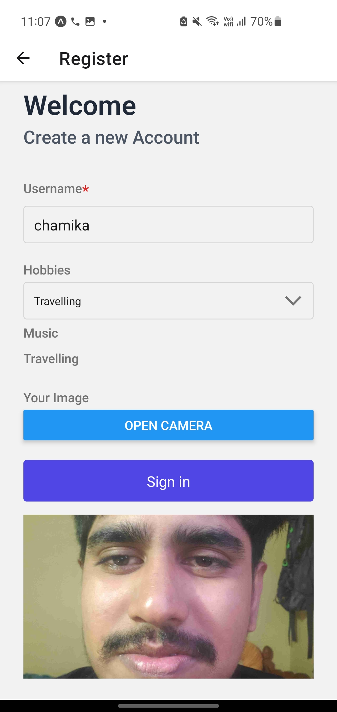
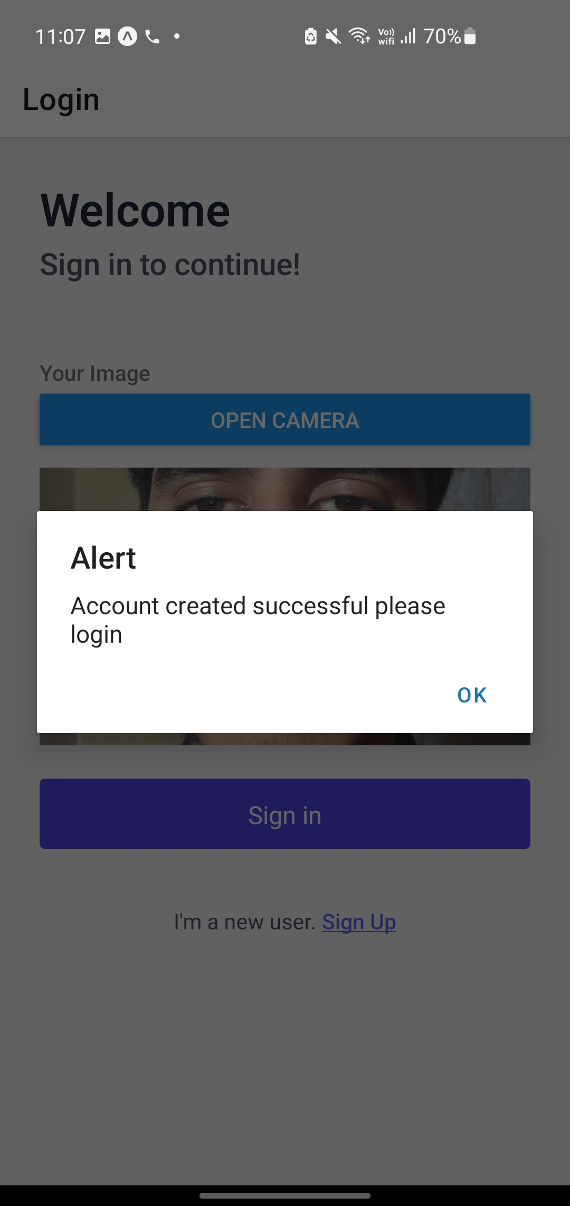
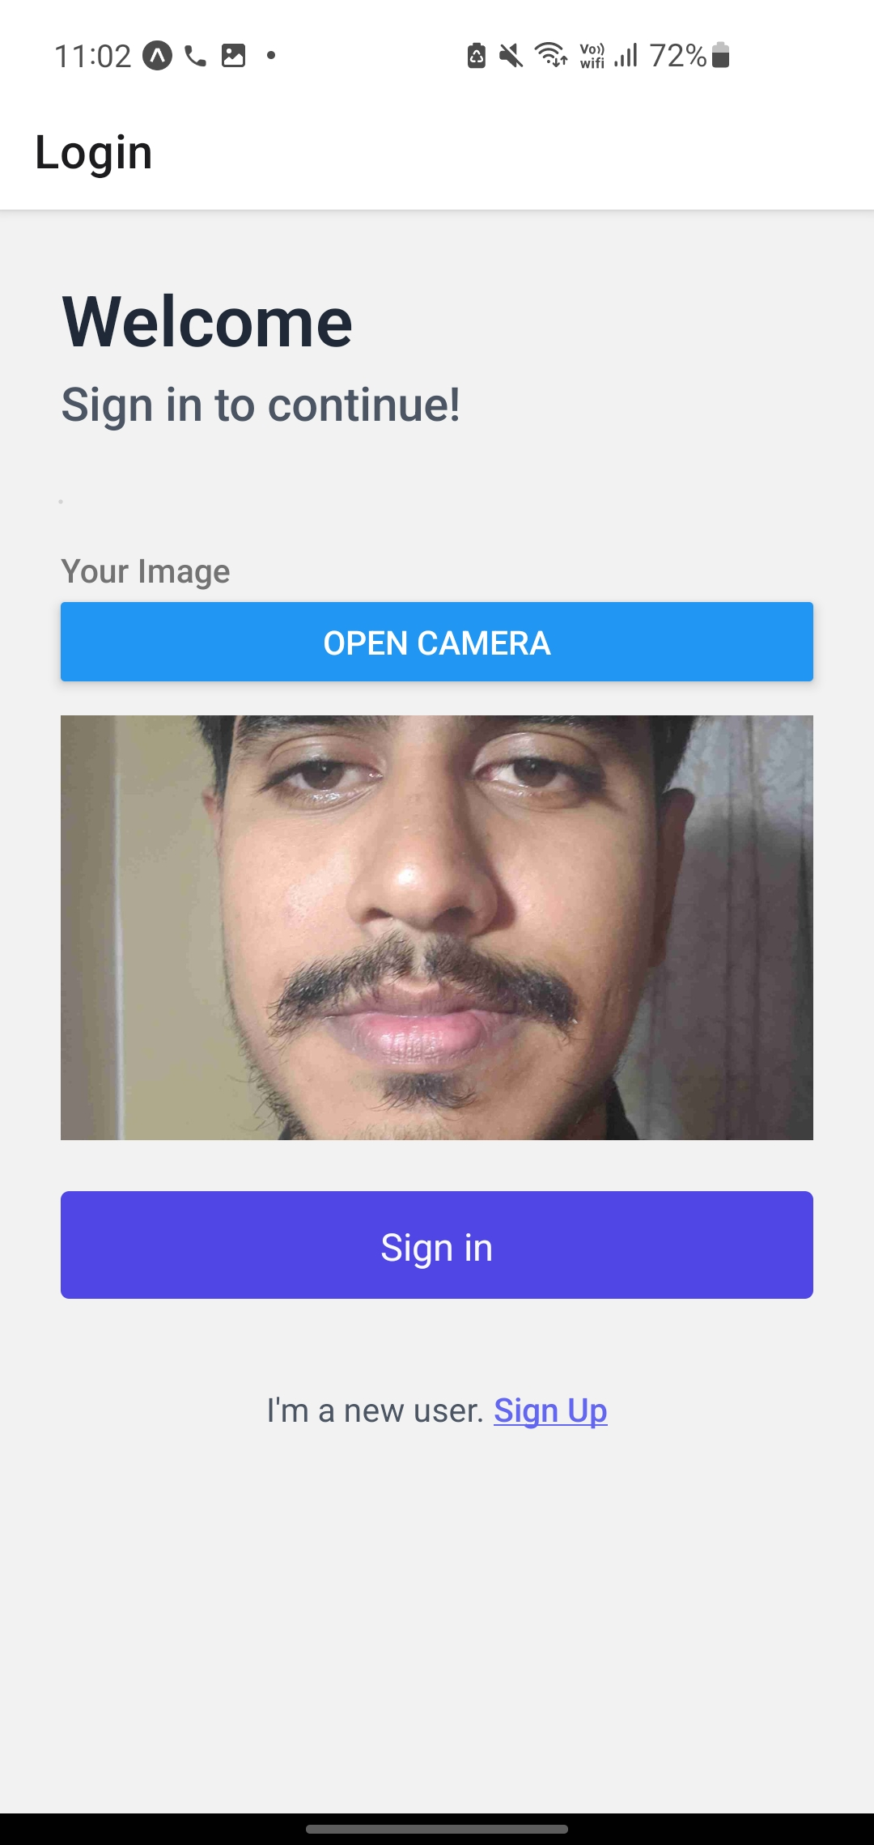
Output
Authentication using Face recognition
IT19216010 | Herath H.M.C.P. | 2022-200

Slide 16
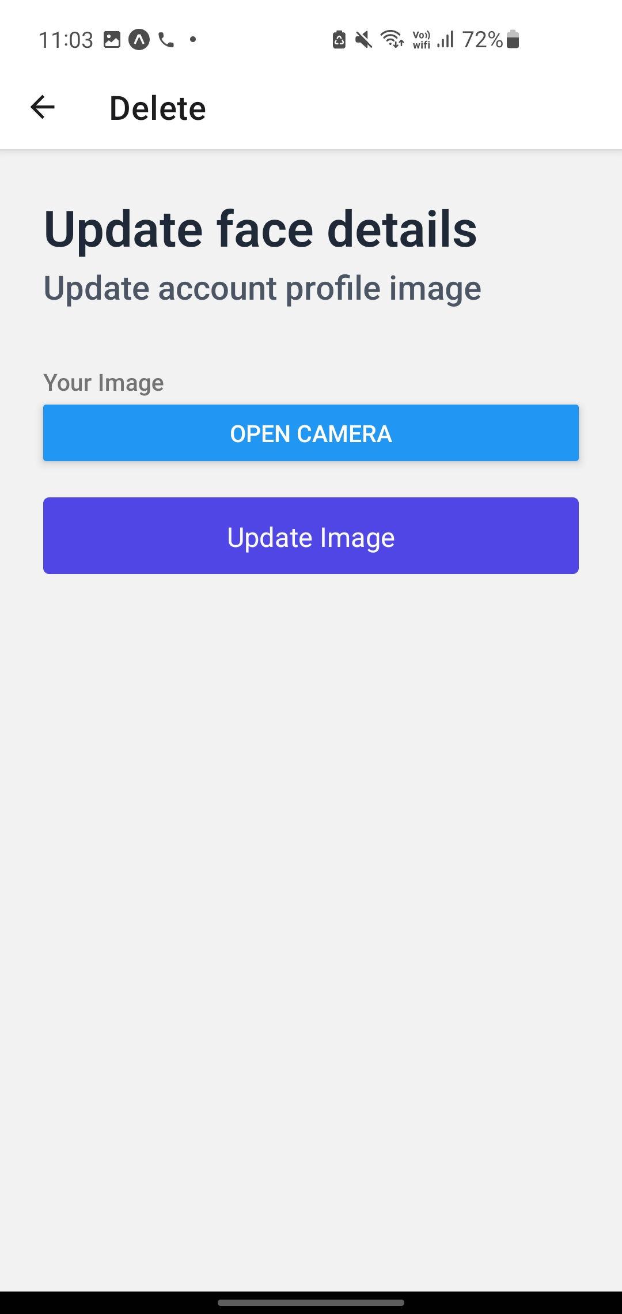
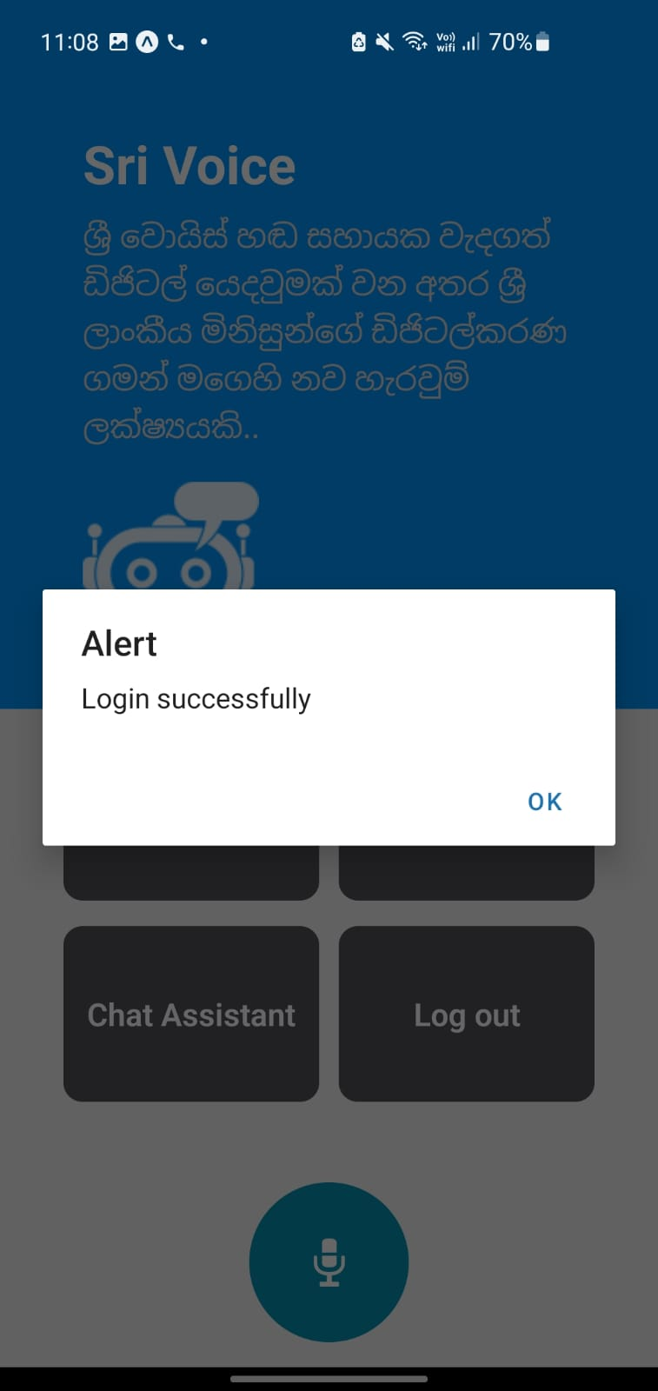
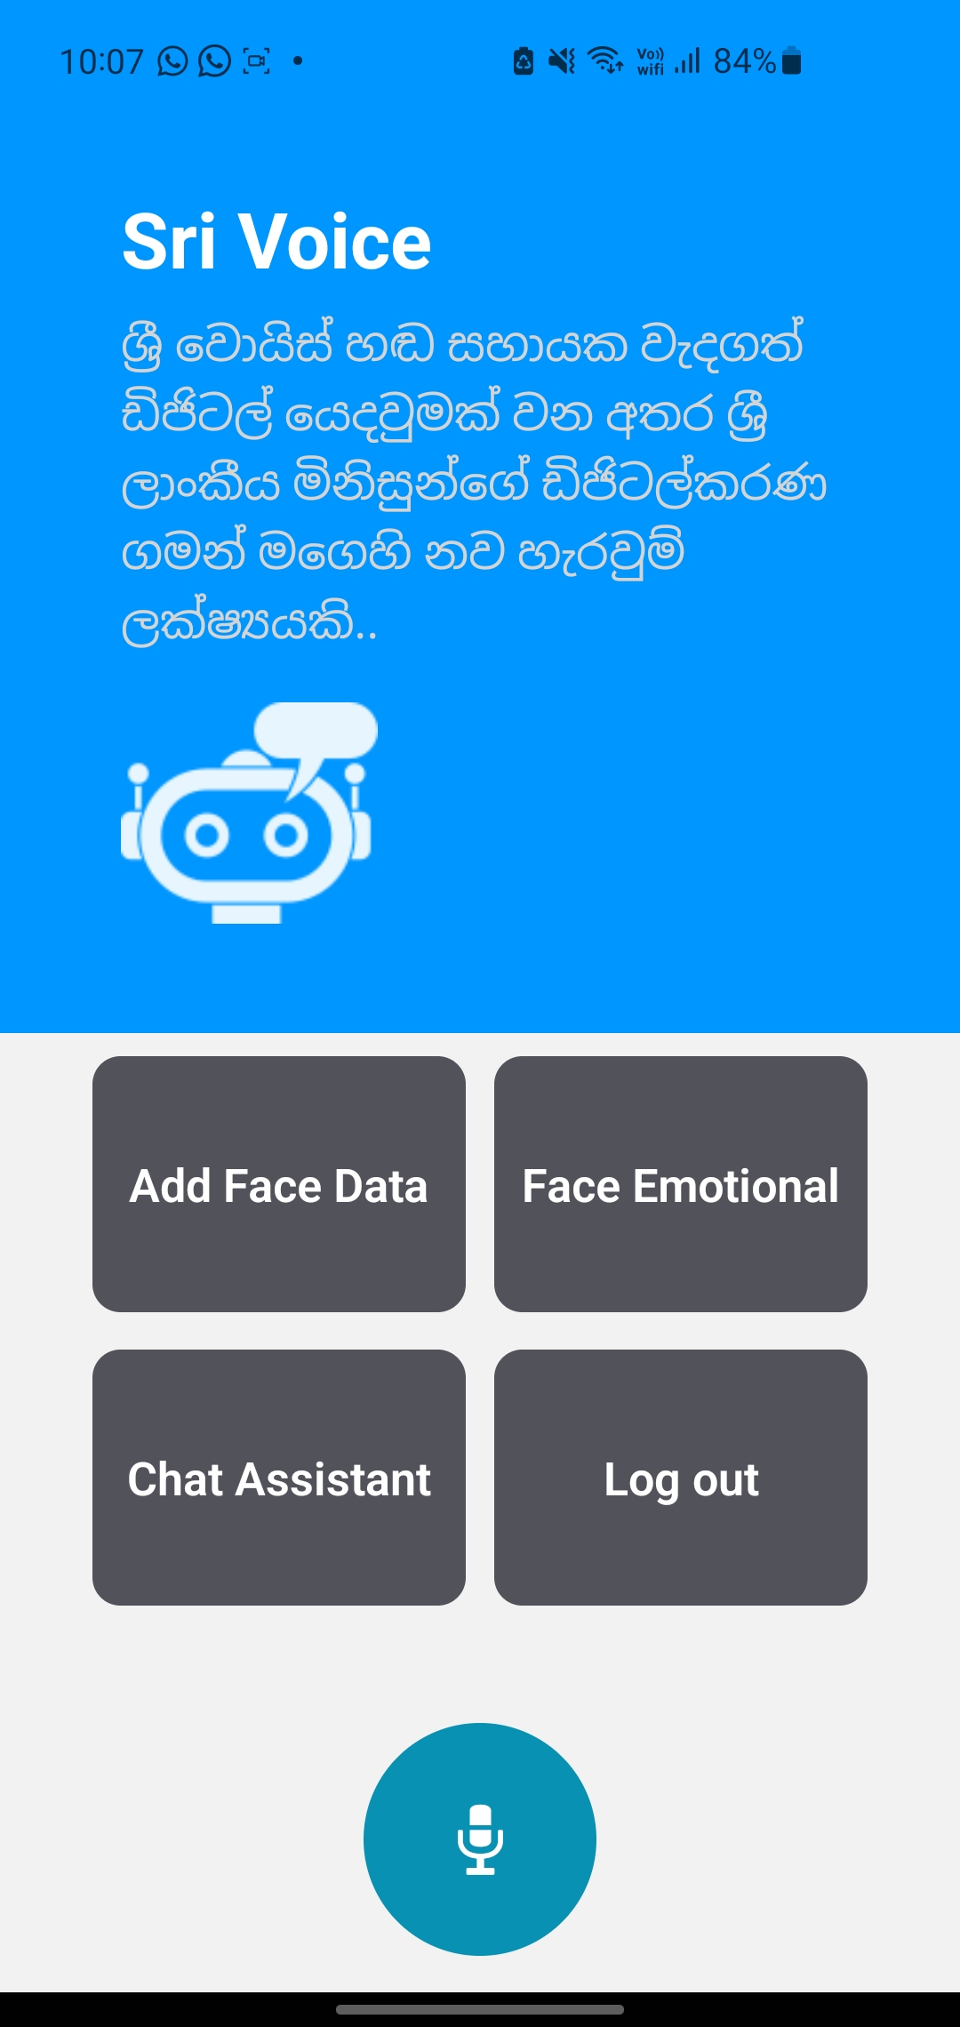
Output
Authentication using Face recognition
IT19216010 | Herath H.M.C.P. | 2022-200

Slide 17
Sinhala Voice to text conversion and provide accurate English phrases
Bandara V.D.
IT19808994
IT19808994 | Bandara V.D. | 2022-200

Slide 18
Research Questions
How to recognize users’ speech commands more accurately in the Sinhala language?
How to reduce the time delay of the speech-to-text conversion method?
How to avoid human errors in the speech recognition process in the Sinhala language?
What are the available voice-to-text conversion methods
IT19808994 | Bandara V.D. | 2022-200

Slide 19
Specific and Sub Objectives
Specific Objective
Improve the capability of providing the most relevant responses to the users’ voice commands by developing accurate voice-to-text conversion and accurate English translation.
Sub Objectives
Speech Recognition (Speech-to-text conversion)
Providing English translation ( T5 Model)
IT19808994 | Bandara V.D. | 2022-200

Slide 20
Requirements
Functional
Non- Functional
User
Should have a Sinhala voice recognition method with a good accuracy rate and less processing time
Should have a method to give accurate English phrases in a less time.
Accuracy of the Sinhala voice recognition.
Efficiency of Sinhala speech recognition.
Accuracy of the created English phrase.
To give voice commands.
To ask questions.
To get answers.
To see the user’s commands as a Sinhala text
To manage daily tasks.
IT19808994 | Bandara V.D. | 2022-200

Slide 21
How did I start?
In the first step, I tried to find methods to train a model to create a Sinhala dataset that can give accurate Sinhala words to voice inputs.
Then I found that was practically time-consuming and accuracy can be very less since those are Sinhala voice commands. Also, Existing Sinhala datasets have very less accuracy
Then I found the google cloud API which gives more accuracy in Sinhala voice-to-text conversion
Then I trained a Text to Text Transfer Transformer Model by fine-tuning an existing dataset to get accurate English outputs to Sinhala text outputs
Start the implementation
IT19808994 | Bandara V.D. | 2022-200

Slide 22
Technologies/ Techniques/ Algorithms
Technologies / Tools
Python – Backend Programming Language
Flask – Backend Framework
React Native – Front-end development
Libraries – Google speech recognition
IDE - PyCharm
Voice recognition system - Google Cloud
version control - GitHub / GitLab
English Translation – Text-to-Text Transfer Transformer Model
Algorithms
Voice Recognition
English Translation
IT19808994 | Bandara V.D. | 2022-200

Slide 23
Voice Detection Implementation Workflow
Sinhala voice capturing by Android application
Converting the captured voice input to an audio file
Transferring the audio file to the backend through API
Converting the audio file to a Sinhala text
Transferring the Sinhala text output to the frontend through API
Getting the English translation of the Sinhala text by using T5 model
Transferring it to the Chat assistant
IT19808994 | Bandara V.D. | 2022-200

Slide 24
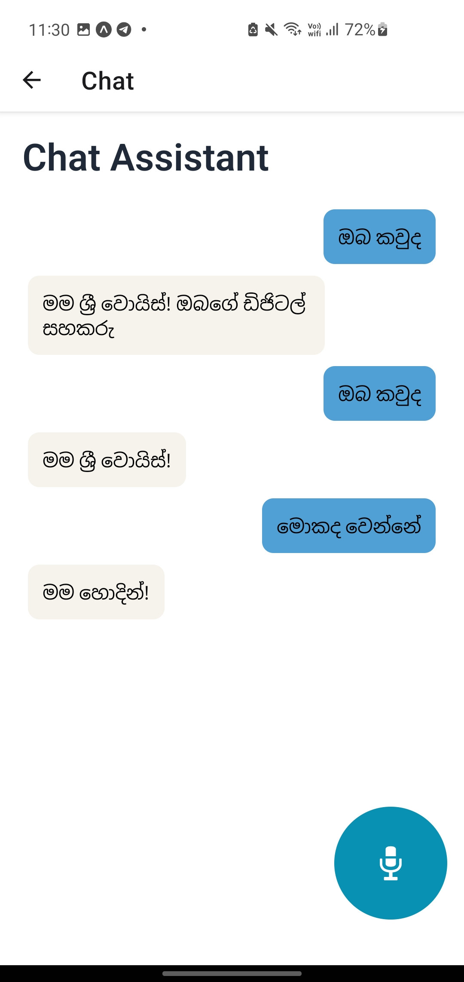
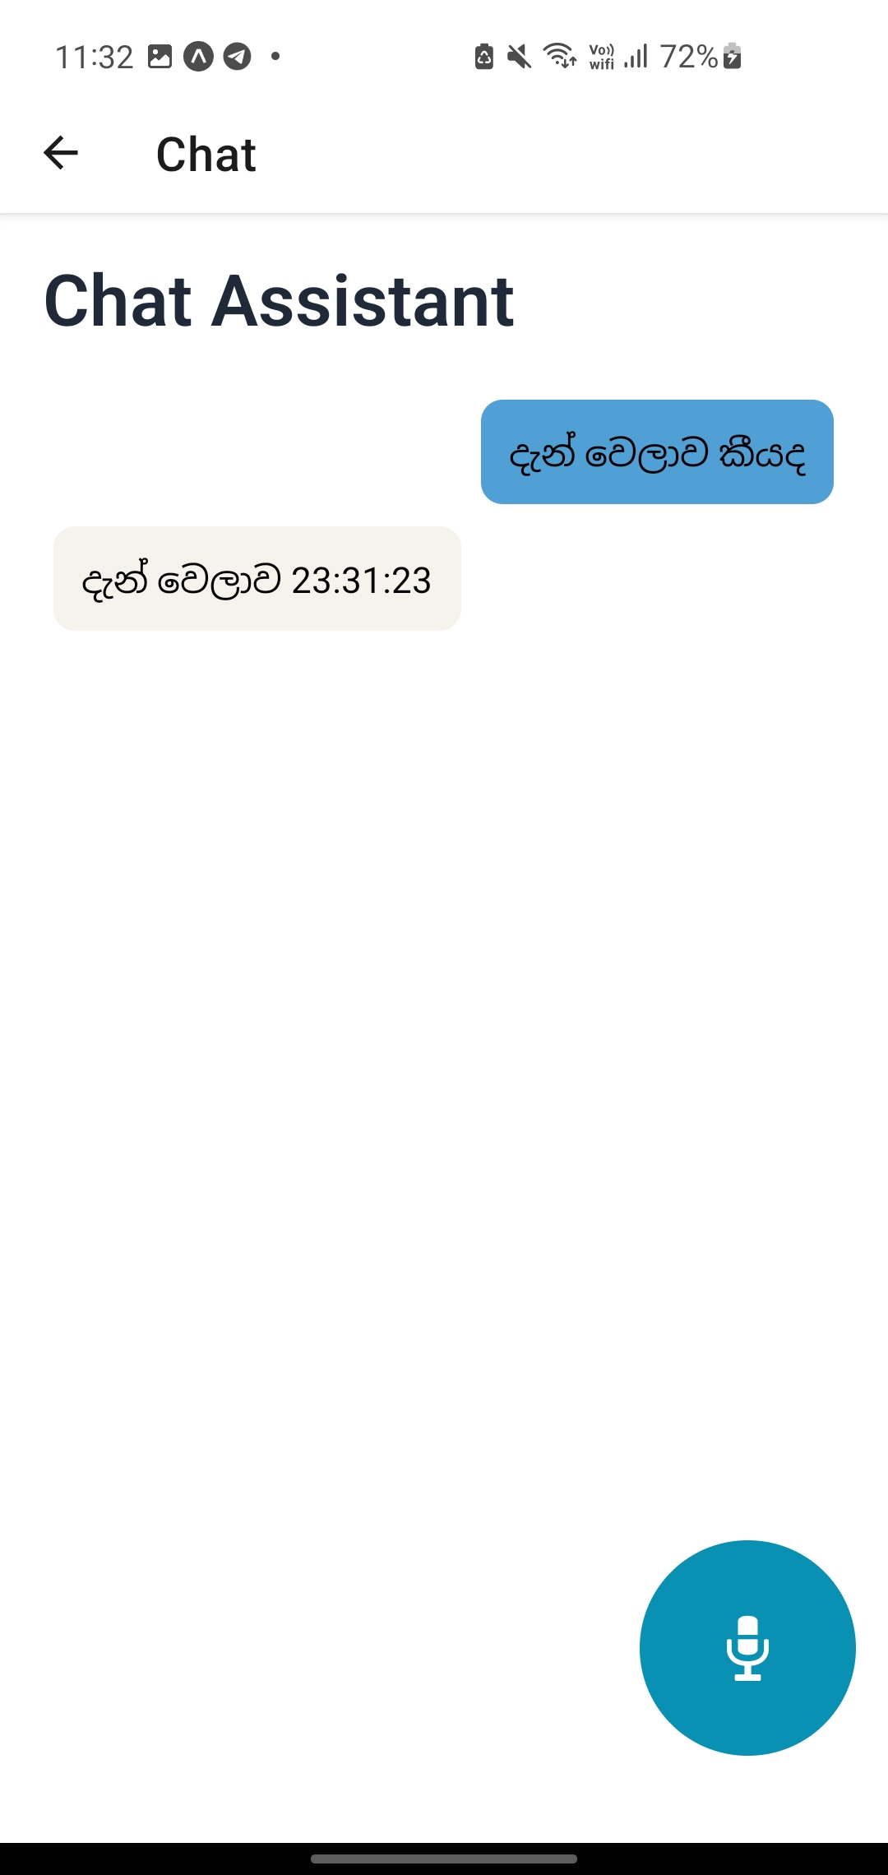
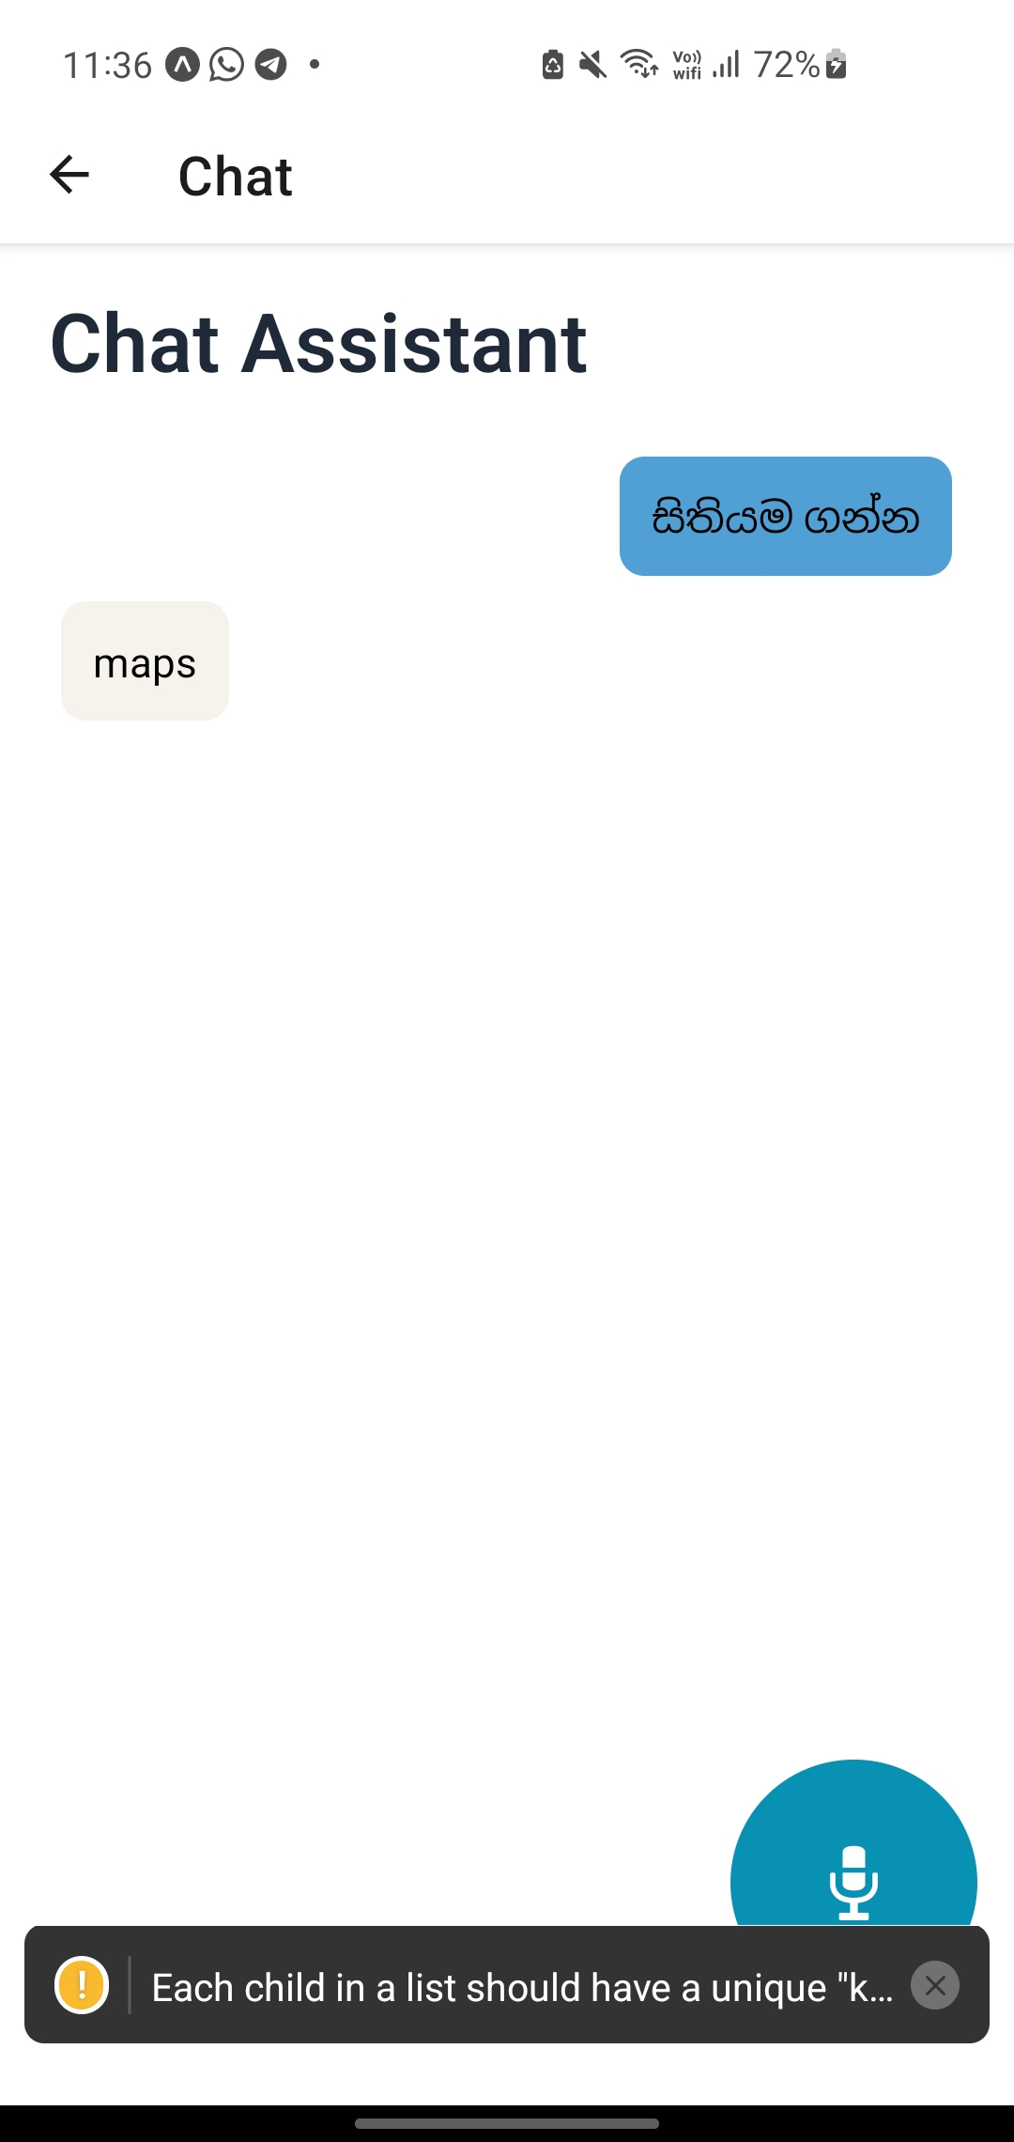
Output-Speech to text and English phrase generation
IT19808994 | Bandara V.D. | 2022-200

Slide 25
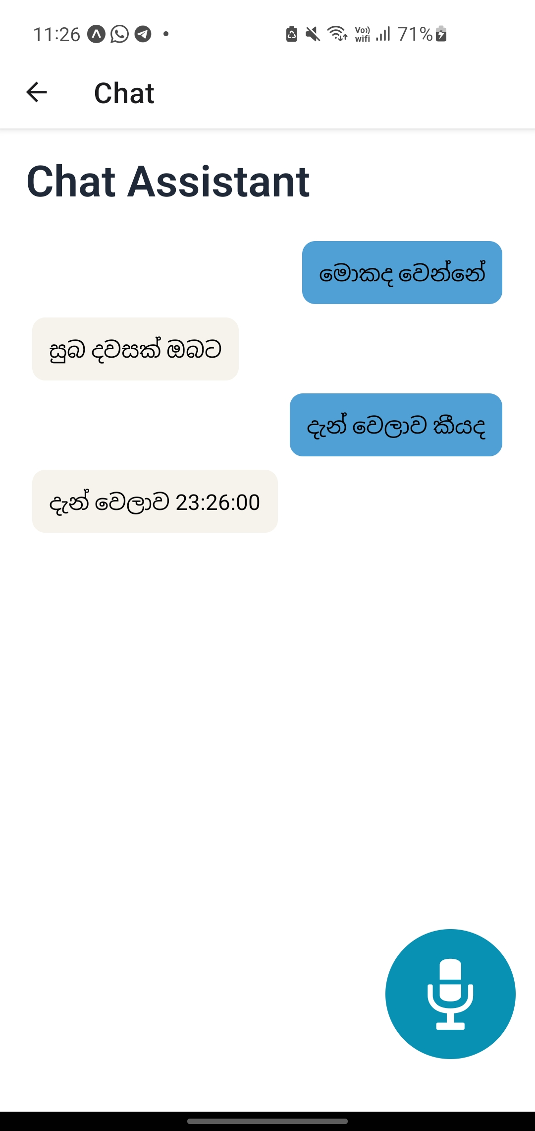
Output-Speech to text and English phrase generation
IT19808994 | Bandara V.D. | 2022-200

Slide 26
Providing accurate voice & outputs according to the user’s commands
Nirash J.M.I.
IT19159768

Slide 27
Research Questions
How to give accurate voice output and text demonstration, in the Sinhala language?
How should the answer be given according to the relevant command of the user?
When the user requests an address.
when the user request to open the camera.
When the user starts a chat conversation with the assistant.
IT19159768 | Nirash J.M.I. | 2022-200

Slide 28
Specific and Sub Objectives
Specific Objective
Providing accurate voice output and text, according to the user's command.
Sub Objectives
Create an algorithm for Sinhala chat conversation
Training a machine learning model.
Implementing an API to frontend android application.
Find the relevant answer from intents based dataset
IT19159768 | Nirash J.M.I. | 2022-200

Slide 29
Requirements
Functional Requirements
According to the user's command, there should be a method to find out whether the relevant answer should be given from the device or from the internet.
There should be a method to say the relevant answer correctly and quickly in Sinhala.
There should be a method to display the answer in Sinhala on the display.
Non-Functional Requirements
Efficiency of providing relevant answers
The efficiency of providing relevant output in Sinhala voice and demonstrating Sinhala text in the display.
User Requirements
Answer the user in Sinhala voice and text output.
Display relevant answers for the user command.
IT19159768 | Nirash J.M.I. | 2022-200

Slide 30
How I Started?
As a first step I Learned technology from scratch, because of less experience in python programming.
Then As the first step, I try to request some existing datasets for my component. but, I couldn't find a relevant dataset.
Learned how to build a model with python. It's for the text chat conversation.
I study and practice the python related technologies that can be helpful to implement this component.
Start component implementation
IT19159768 | Nirash J.M.I. | 2022-200

Slide 31

Technologies/ Techniques/ Algorithms
Technologies / Tools
Python – Programming Language
React Native – Front-end development
Libraries – NumPy, TensorFlow, Keras, Scikit-learn, Label Encoder, Colorama
IDE – PyCharm
Anaconda Distribution, Jupyter Notebook
version control – GitHub / GitLab
IT19159768 | Nirash J.M.I. | 2022-200

Slide 32
Chat Assistant implementation workflow
Creating the intents based dataset
Identifying the user command according to patterns
Creating output using Neural Machine Translation method
Giving the chat output using intents based dataset
Giving the voice output using java modified text to speech API
Train the model using dataset
IT19159768 | Nirash J.M.I. | 2022-200

Slide 33
Output – Responses from chat assistant
IT19159768 | Nirash J.M.I. | 2022-200

Slide 34
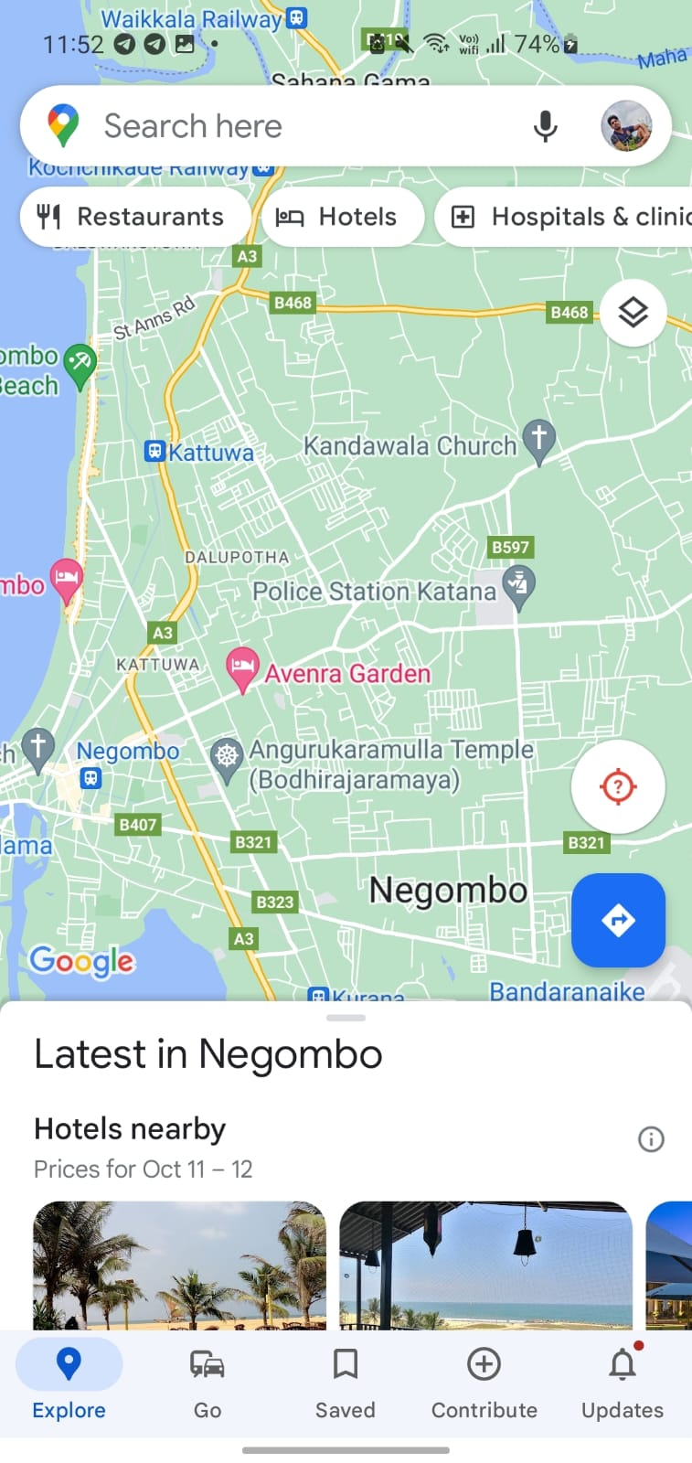
Output – Responses from chat assistant
IT19159768 | Nirash J.M.I. | 2022-200

Slide 35
Ideal Suggestion generation according to the real-time situation and enjoyment
SENARATHNE K.H.I.R.
IT19152592

Slide 36
Research Questions
How to identify users' feelings and emotions via camera?
How to identify users face
How to provide ideal suggestions according to users' real-time emotions?
How to increase mental freedom through the Sinhala voice suggestions?
IT19152592 | Senarathne K.H.I.R. | 2022-200

Slide 37
Specific and Sub Objectives
Specific Objective
Provide most suitable and ideal suggestions to the user according to real-time emotions and function like a closed and trusted friend to user.
Sub Objectives
Identify users’ facial expressions.
Identify users’ emotions according to the expressions.
Analyze user and the preferences.
Generate Sinhala voice suggestions.
IT19152592 | Senarathne K.H.I.R. | 2022-200

Slide 38
Requirements
Functional Requirements
Should have a method to identify expressions from the face.
Should have a method to identify emotions from the facial expressions.
Should have a method to provide ideal suggestions according to the real-time situation.
Non-Functional Requirements
The Efficiency and performance of identification of the facial expressions.
The Efficiency of providing ideal suggestions according to real time situation.
User Requirements
To provide ideal suggestions according to the real-time situations.
To provide enjoyment.
IT19152592 | Senarathne K.H.I.R. | 2022-200

Slide 39
How I Started?
As a first step I Learned technology from scratch, because of less experience in python programming.
Tried sample projects based on current area
Learned how to implement a model using ML technologies and a training a model
Find a dataset which compatible to do a research
Because of the foreign dataset created owned Sri Lankan Dataset
Trained Emotion recognition model
Integrated with FrontEnd API
Develope frontend sections related to emotion classification
IT19152592 | Senarathne K.H.I.R. | 2022-200

Slide 40
Technologies/ Techniques/ Algorithms
Technologies / Tools
Python – Backend Programming Language
Flask – Backend Framework
React Native – Front-end development
Libraries – NumPy, TensorFlow, Keras, OpenCV, Scikit-learn
IDE – PyCharm
Google Colab, Anaconda Distribution, Jupyter Notebook
version control – GitHub / GitLab
IT19152592 | Senarathne K.H.I.R. | 2022-200

Slide 41
Suggestions generation and make enjoyment the user - Workflow
Getting the dataset
Train the emotion recognition model
Integrate the emotion recognition model with the frontend API
Identify the Realtime emotions from the face
Get User preferences
Generate suggestions by based on preferences & emotion level
Output the accurate and ideal suggestions and improve user mental freedom
Train the emotion model again using custom create dataset
IT19152592 | Senarathne K.H.I.R. | 2022-200

Slide 42
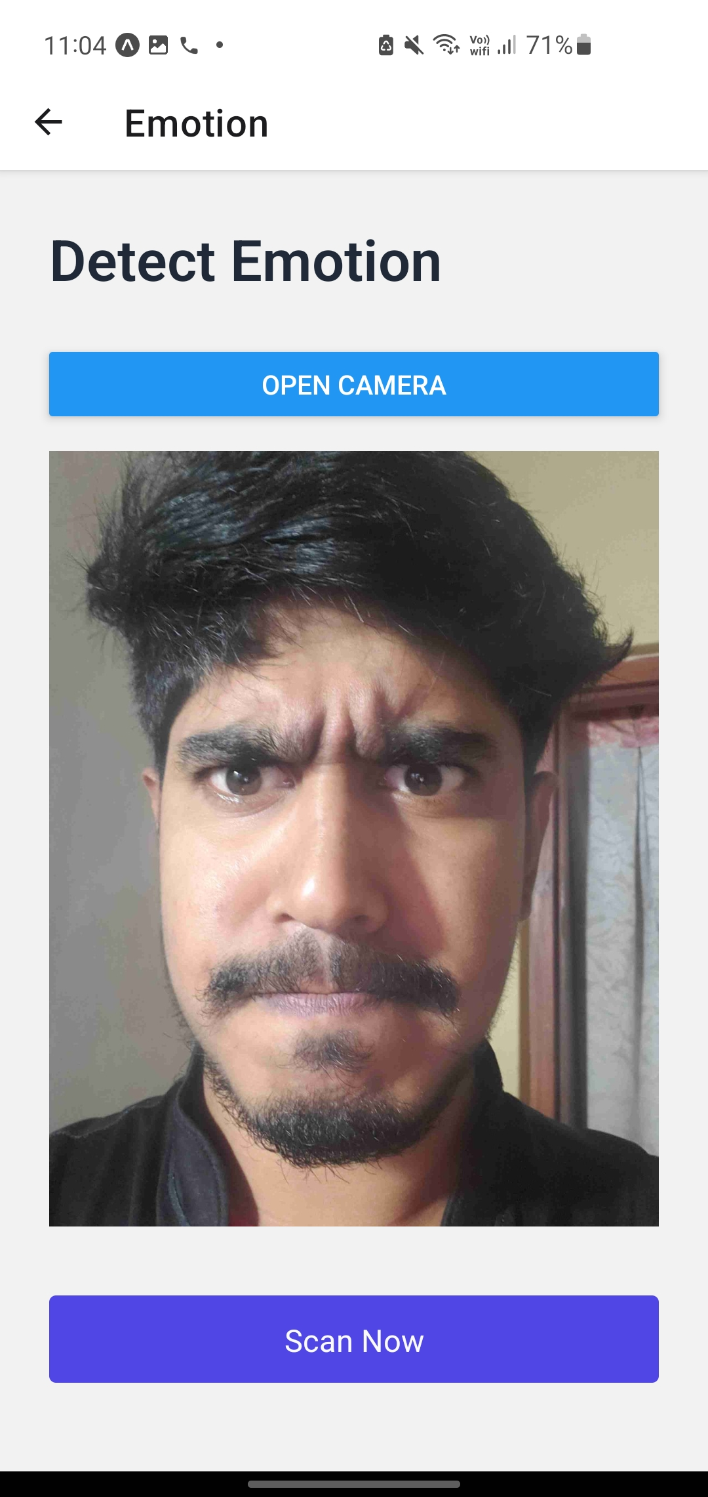
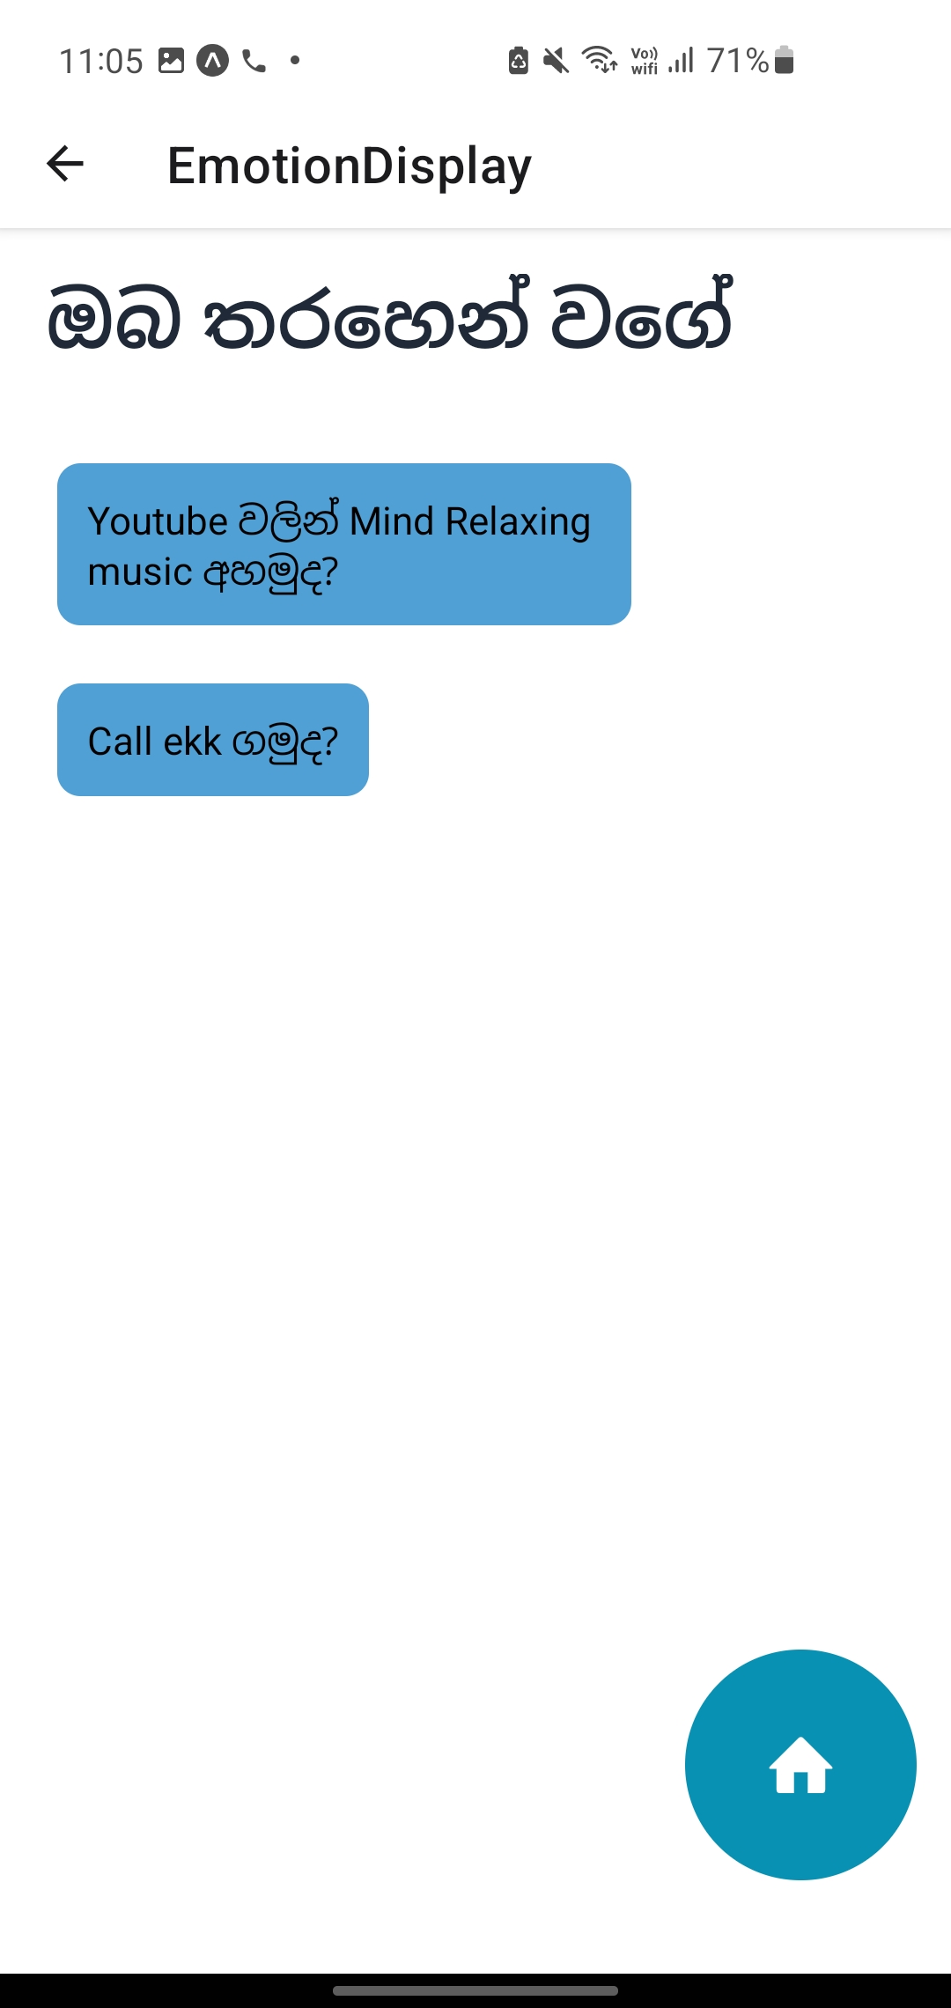
Output -Emotional recognition
IT19152592 | Senarathne K.H.I.R. | 2022-200

Slide 43
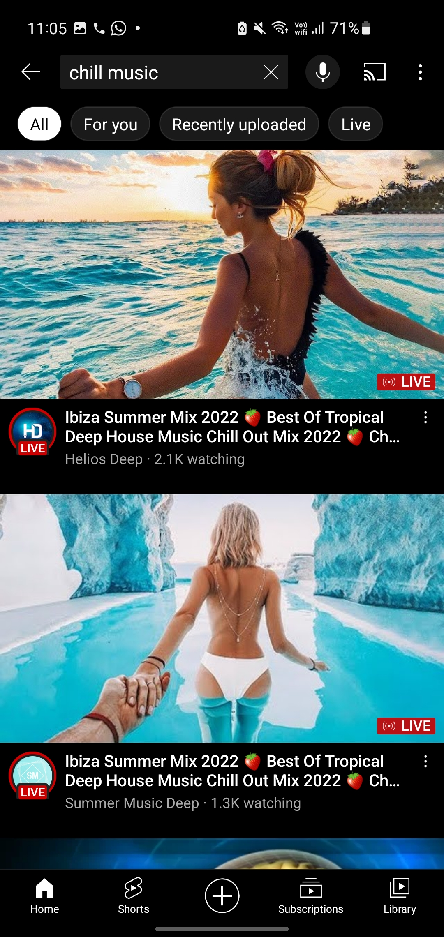
Output -Emotional recognition
IT19152592 | Senarathne K.H.I.R. | 2022-200

Slide 44
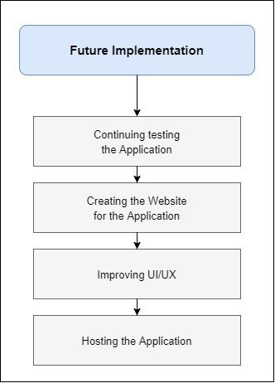
Future Implementation

Slide 45
Thank you!

